Slide 1
Flu Shot Final Exam
Submitted By
M. Rafiq Lakhani

Slide 2
Flu Shot - Predict whether people will get H1N1 and Seasonal Flu Vaccines
Task:
Predict whether people will get H1N1 and seasonal flu vaccines using information they shared about their backgrounds, opinions, and health behaviors in a National 2009 H1N1 Flu Survey conducted in USA
A better understanding of characteristics associated with personal vaccination patterns can provide guidance for future public health efforts.

Slide 3
Conclusion
22** features have influence on Predictions.
Full list is provided in another slide
Note: some features in this group may be more significant then others most significant features are:
'behavioral_touch_face',
'doctor_recc_h1n1
'opinion_h1n1_vacc_effective',
'opinion_h1n1_sick_from_vacc',
'opinion_seas_vacc_effective',
Area under ROC Curve is 85%
Macro Average ROC (multi-class) is 84%
Submission files with Probability Predictions has been created
** This was determined by Lasso Analysis & Scaling

Slide 4
Background
We will take a look at vaccination, a key public health measure used to fight infectious diseases. Vaccines provide immunization for individuals, and enough immunization in a community can further reduce the spread of diseases through "herd immunity.“

Slide 5
A vaccine for the H1N1 flu virus became publicly available in October 2009. In late 2009 and early 2010, the United States conducted the National 2009 H1N1 Flu Survey.
This phone survey asked respondents whether they had received the H1N1 and seasonal flu vaccines, in conjunction with questions about themselves.
These additional questions covered their social, economic, and demographic background, opinions on risks of illness and vaccine effectiveness, and behaviors towards mitigating transmission.
A better understanding of how these characteristics are associated with personal vaccination patterns can provide guidance for future public health efforts.

Slide 6
About Data:
There are two target variables:
h1n1_vaccine - Whether respondent received H1N1 flu vaccine.
seasonal_vaccine - Whether respondent received seasonal flu vaccine.
Both are binary variables: 0 = No; 1 = Yes. Some respondents didn't get either
vaccine, others got only one, and some got both. This is formulated as a multilabel (and not multiclass) problem.

Slide 7
The features in this dataset
There are 36 columns in this dataset.
The first column respondent_id is a unique and random identifier.
The remaining 35 features are described below.
There are 13 Numeric Features having binary variables
For all binary variables: 0 = No; 1 = Yes.
There are 10 Numeric Non-Binary Variables
There are 10 Object variables
All of the above seem to have Categorical values and therefore will be converted type Categorical
There are 2 Object variables which will not be modified
Categorical variables were encoded by using dummy variables.
his is required to convert the Categorical Variables to Numeric to make them ready for processing by regression models
After encoding total number of columns are 154
Out of these 69 (original 22) columns have influence on Predictions.
This was determined by Lasso Analysis & Scaling
List of these columns is attached in next slide

Slide 8
List of Columns having influence on Predictions
'behavioral_antiviral_meds',
'behavioral_avoidance',
'behavioral_face_mask',
'behavioral_wash_hands',
'behavioral_large_gatherings',
'behavioral_outside_home',
'behavioral_touch_face',
'doctor_recc_h1n1',
'doctor_recc_seasonal',
'chronic_med_condition',
'child_under_6_months',
'health_worker',
'health_insurance',
'opinion_h1n1_vacc_effective',
'opinion_h1n1_risk',
'opinion_h1n1_sick_from_vacc',
'opinion_seas_vacc_effective',
'opinion_seas_risk',
'opinion_seas_sick_from_vacc',
'age_group',
'education',
'race',
Note: some features in this group may be more significant then others
'behavioral_touch_face',
'doctor_recc_h1n1
'opinion_h1n1_vacc_effective',
'opinion_h1n1_sick_from_vacc',
'opinion_seas_vacc_effective',
This was determined by Lasso Analysis & Scaling

Slide 9
Process:
Data Evaluation, Analysis and Cleaning
Was done for:
training_set_features
test_set_features
training_set_labels
These files were mostly clean except for having “Nulls”
These nulls were removed by “mode method” in Numeric Columns because the data they had was in whole numbers and if we had used “mean” then it would have introduced fractions (decimal point)
For Object / Text columns both “ffill” & “bfill” parameters of “fillna” were used

Slide 10
Multiple models / Algorithms were tested / evaluated
To make Probability Predictions
LogisticRegression model was selected
To Calculate ROC_AUC MACRO (Multi-Class)
OneVsRestClassifier Classifier was used
roc_auc_score was used to calculate
One-vs-One ROC AUC scores
One-vs-Rest ROC AUC scores
Results of these are presented in next few slides

Slide 11
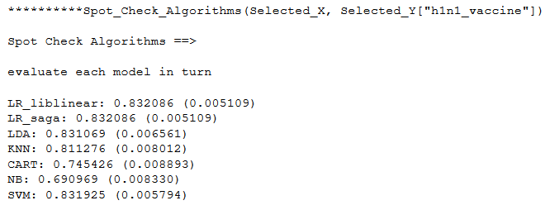
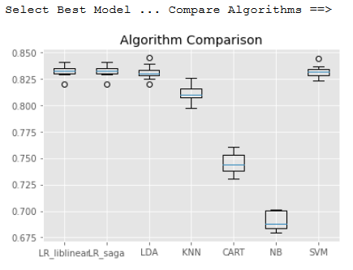
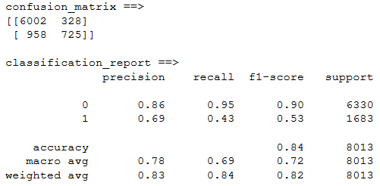
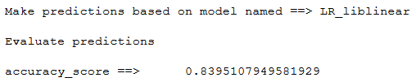
Spot_Check_Algorithms (Selected_X, Selected_Y["h1n1_vaccine"])

Slide 12
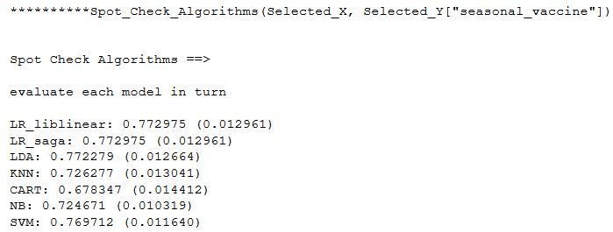
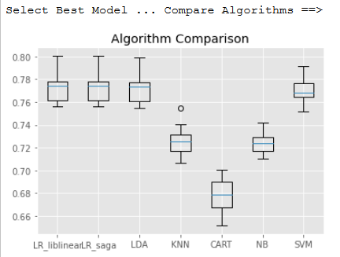
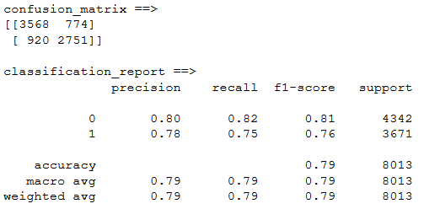

Spot_Check_Algorithms(Selected_X, Selected_Y["seasonal_vaccine"]

Slide 13
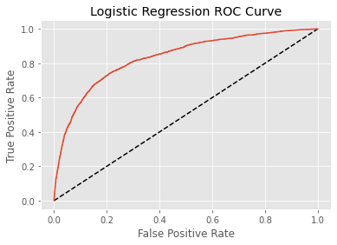
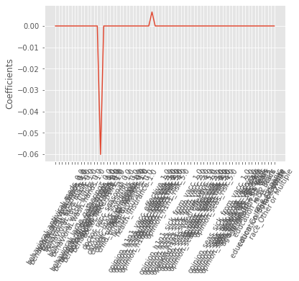
Run ROC_AUC_Cycle on Selected DF_N_enc "h1n1_vaccine"

Slide 14
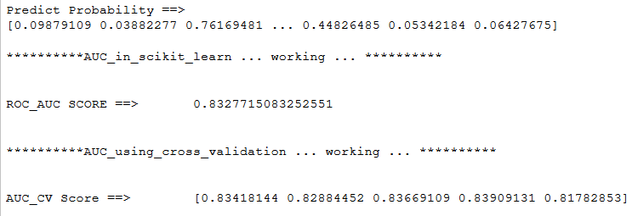
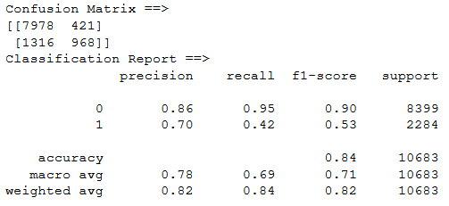
Run ROC_AUC_Cycle on Selected DF_N_enc "h1n1_vaccine"

Slide 15
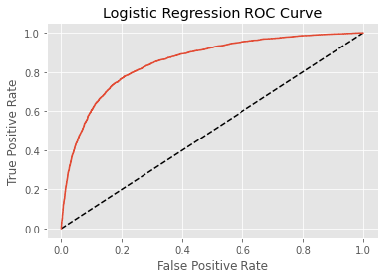
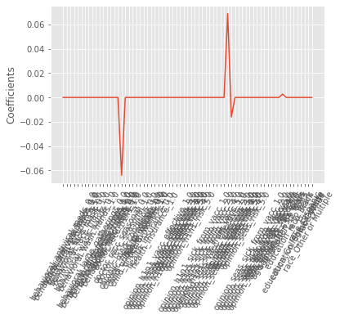
Run ROC_AUC_Cycle on Selected DF_N_enc "seasonal_vaccine"

Slide 16
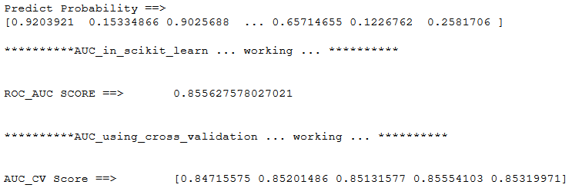
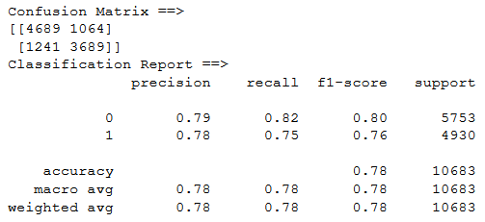
Run ROC_AUC_Cycle on Selected DF_N_enc "seasonal_vaccine"

Slide 17
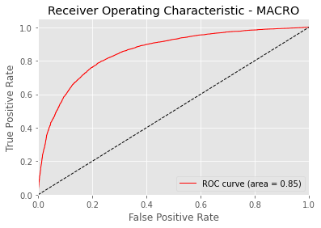
ROC_AUC using MACRO

Slide 18
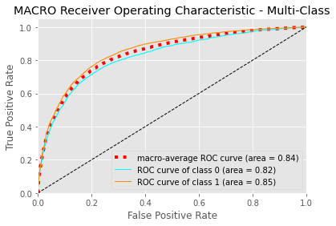
ROC_AUC using MACRO - Multiclass

Slide 19
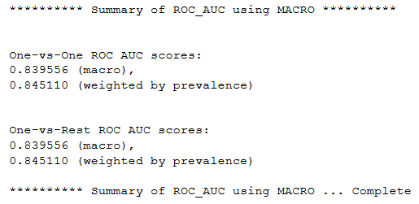
ROC_AUC using MACRO Summary

Slide 20
Submission File
The model saved during the above process was loaded to make Probability Predictions on the target data
And submission file created
Result in next slide

Slide 21
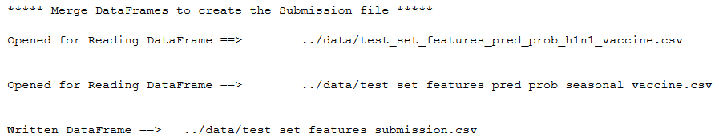
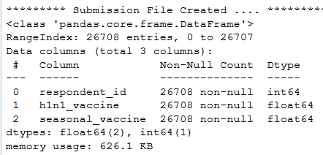
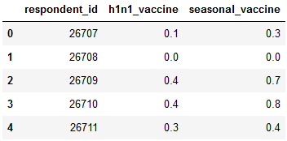
Predict Probabilities & Create Submission File
Step #4 - Merge DataFrames to create the Submission file

Slide 22
Summary of our working & results obtained are presented here.
Details are in the source code file
Flu Shot - Final Exam - MRL.ipynb

Slide 23
Define & Test Functions
Note: we will be Testing, Exploring, Cleaning & Manipulating both files
df = df1n = "training_set_features"
dfTest_Fea = df3n = "test_set_features"

Slide 24
REVIEW NUMERIC COLUMNS
REVIEW NUMERIC COLUMNS
Shape
Count
Nulls - Any
Nulls - Sum
Value - Minimum
Value - Maximum
Describe
Outliers
Check whether Nulls can be Replaced with statistical measures
Mean
mode

Slide 25
REVIEW NUMERIC COLUMNS
Replacing NULLs by using statistical measures
mean
mode
Replace Nulls in Numeric Column
Replace NULLs in all Numeric Columns
based on the supplied list of Columns

Slide 26
REVIEW NUMERIC COLUMNS
Replace Nulls in Columns having type "OBJECT"
RUN THIS ONLY AFTER NULLs have been REMOVED from NUMERICs
Check whether Data in the Column is within the provided Range
Basically looking for values which may be out of Range
& if there are then take action to resolve them

Slide 27
REVIEW NUMERIC COLUMNS
Data Range Constraints
Review & Plot

Slide 28
Review Text
Dtype
type
Describe
Count
Unique
Head
Tail
Keys
Values
Index
Check Nulls
Check Constrains
Check Status_of_Columns
Check Duplicates

Slide 29
Catagorical
Convert Selected OBJECTs &/or Numeric to type as categorical
Convert_ALL_Listed_to_Catagorical
based on provided List of Object & Numeric Columns

Slide 30
A Full Review of ALL Numeric Columns
Review_Column_Num (Numeric)
Check Data_range_constraints
Check_Range Check_outliers
Check Status_of_Columns
Check_Duplicate_values_short

Slide 31
A Full Review of ALL Numeric Columns is done
Note: we will be Testing, Exploring, Cleaning & Manipulating both files
df = df1n = "training_set_features"
dfTest_Fea = df3n = "test_set_features“
Note: Only one column output is shown here & for other columns the code has been commented to keep the size of the file small

Slide 32
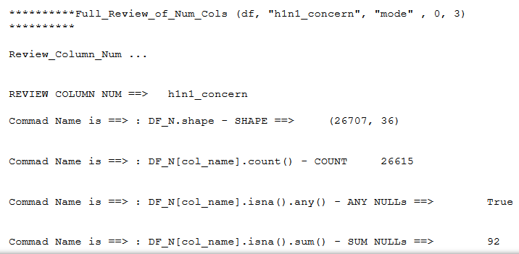

Slide 33
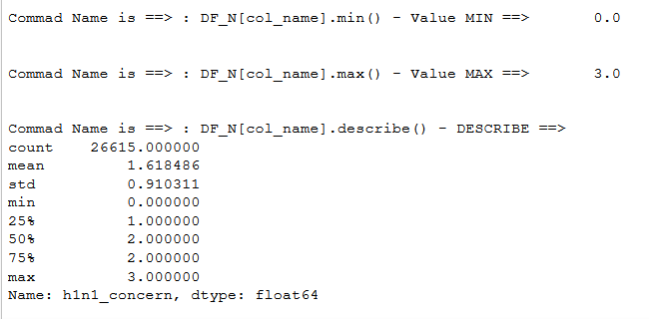

Slide 34
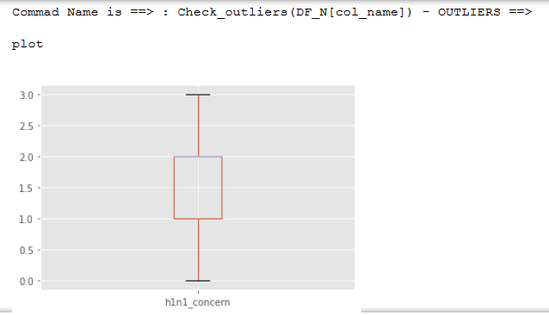

Slide 35
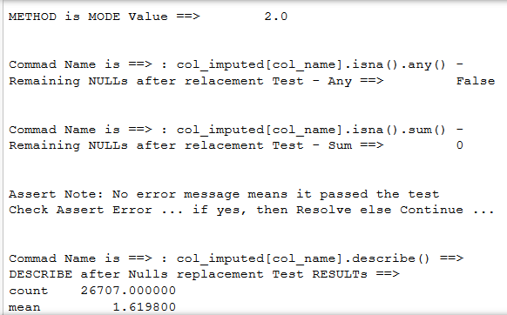

Slide 36
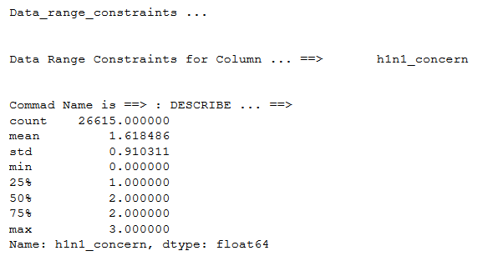

Slide 37
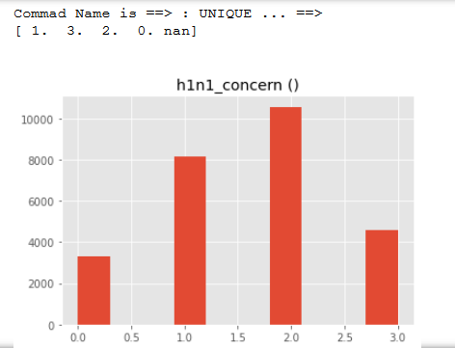

Slide 38
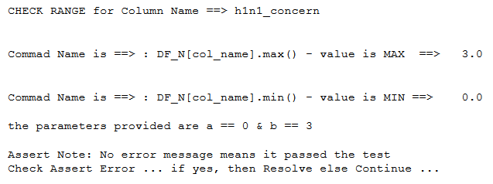
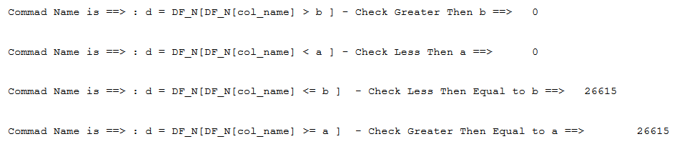

Slide 39
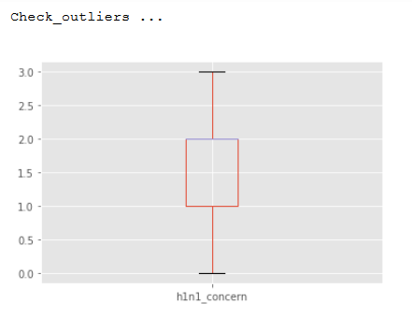

Slide 40
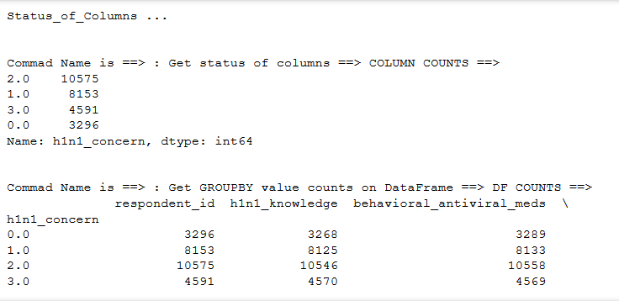

[4 rows x 35 columns]

Slide 41
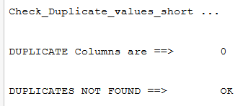

Slide 42
A Full Review of ALL OBJECT (Text) Columns is done
Note: we will be Testing, Exploring, Cleaning & Manipulating both files
df = df1n = "training_set_features"
dfTest_Fea = df3n = "test_set_features“
Note: Only one column output is shown here & for other columns the code has been commented to keep the size of the file small

Slide 43
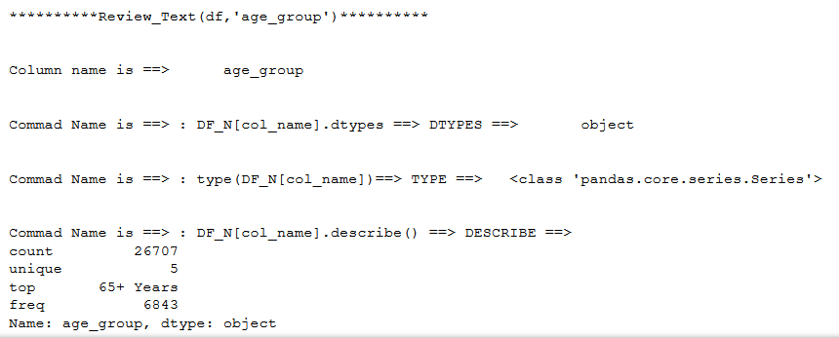

Slide 44
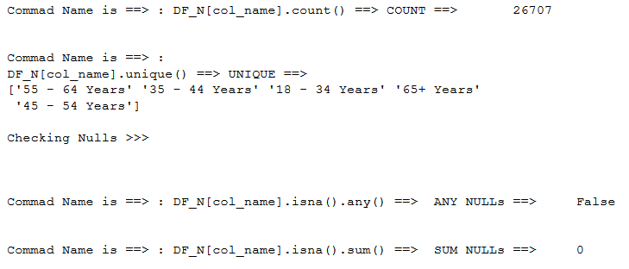
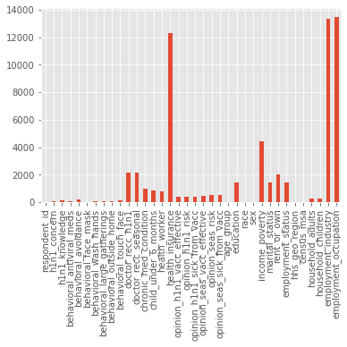
Nulls in a Column
Nulls in the Dataset

Slide 45
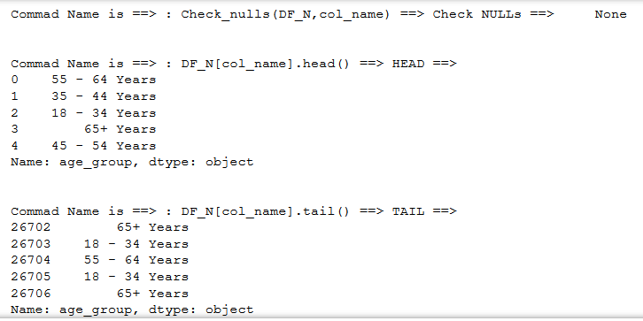

Slide 46
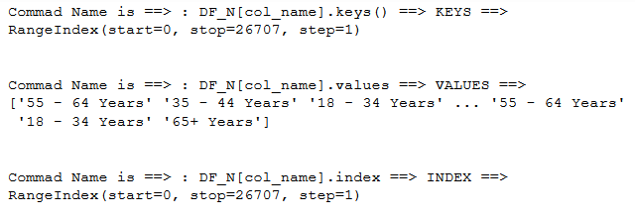
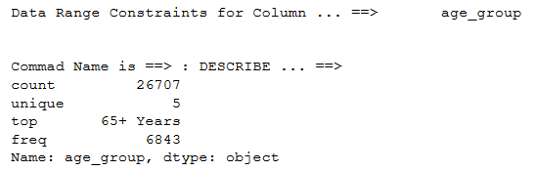

Slide 47
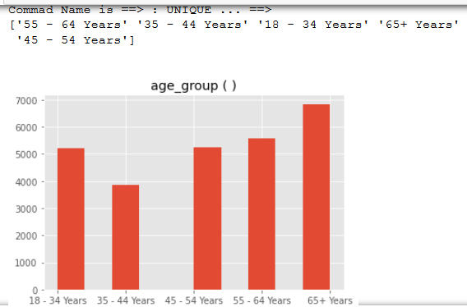

Slide 48
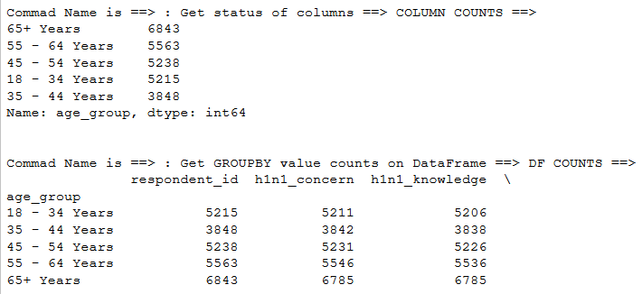


Slide 49
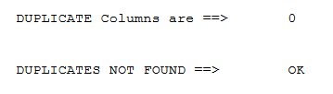

Slide 50
Categorical Features & Encoding
Dealing with categorical features
Function for Encoding dummy variables
This is required to convert the Categorical Variables to Numeric to make them ready for processing by regression models
Note:
* USE THIS ONLY AFTER NULLs have been REMOVED & * OBJs CONVERTED to CATAGORICALs

Slide 51
SUPERVISED LEARNING WITH SCIKIT-LEARN
Linear regression
Function to calculate Ridge Score

Slide 52
SimpleImputer
Function to use SimpleImputer
This is used to remove Nulls
The strategy used here is 'most_frequent'
Reason is becuase values in data are whole numbers (integers)
If 'mean' was used then it could come in decimal point (float) which is not appropriate for this case

Slide 53
Scaling
Scaling in scikit-learn
Scaling is required to bring closer the data range of various variables
This is important before doing regression analysis

Slide 54
Spot Checking of Algorithms
Define function for Spot Checking of Algorithms
Evaluate various regression models
'LR_liblinear' = LogisticRegression(solver='liblinear', multi_class='ovr')
'LR_saga' = LogisticRegression(solver='saga', multi_class='auto')
'LDA' = LinearDiscriminantAnalysis()
'KNN' = KNeighborsClassifier()
'CART' = DecisionTreeClassifier()
'NB' = GaussianNB()
'SVM' = SVC(gamma='auto')

Slide 55
Lasso
Function for Lasso
It is used to identify features which have most influence on the prediction

Slide 56
Logistic regression & ROC_AUC Score & Cross Validation Score & Confusion matrix & its report
Define functions for Logistic regression
& the ROC curve & Plot Graph
Define functions for Calculating & Displaying
ROC_AUC Score & Cross Validation Score
Function to show Confusion matrix & it’s report

Slide 57
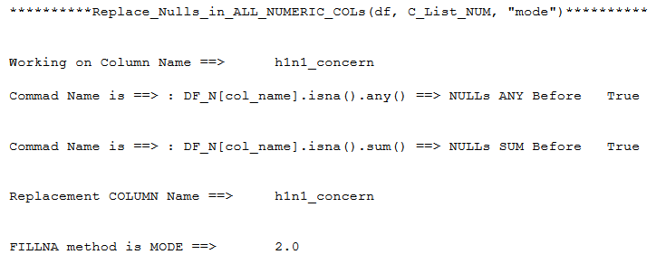
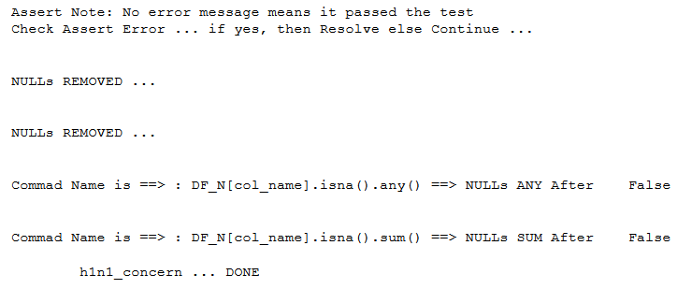
Removing Nulls form ALL Numeric Columns

Slide 58
Removing Nulls form ALL Object (Text) Columns
After first attempt of using “fillna” with “ffill”
There is still one Null present in each of the following two features:
employment_industry &
employment_occupation
Therefore we will have to also use “fillna” with "bfill"
Note: it is rquired in
only one file (df)
& not in other (defTest_Fea)

Slide 59
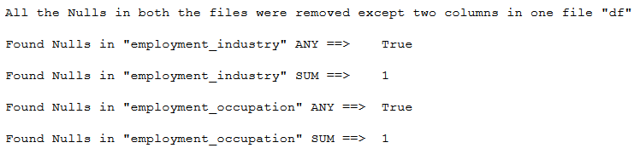
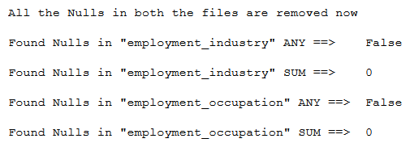
Removing Nulls form ALL Object (Text) Columns
Used fillna with parameter “ffill"
Therefore we will have to also use fillna with parameter "bfill"

Slide 60
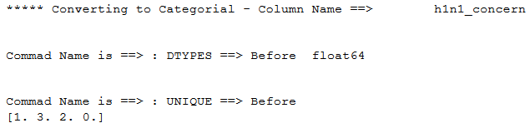
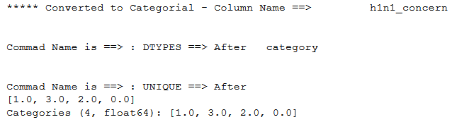
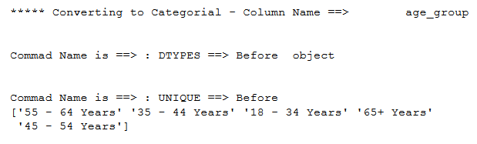
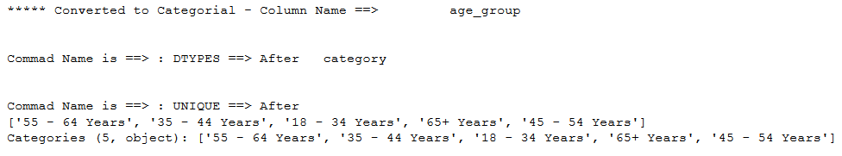
Convert_ALL_Listed_to_Catagorical

Slide 61
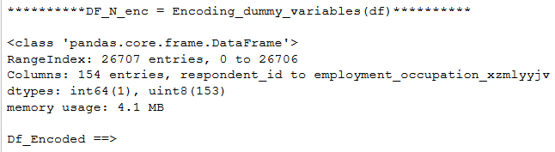
Encoding by dummy_variables
This is required to change the categorical variables to Numeric
Note: Redundant variables created during this process have to be removed but this has not been done for now It will be done later
Note: After Encoding the New DataFrame name is
DF_N_enc

Slide 62
Evaluation by ROC_AUC_Cycle
* Lasso(X_scaled, DF_y[col_name], DF_N_enc_col_names)
* Logistic_regression_ROC_curve(X_scaled, DF_y[col_name], filename, modelname)
* AUC_in_scikit_learn(X_scaled, DF_y[col_name])
* AUC_using_cross_validation(X_scaled, DF_y[col_name])
* Confusion_matrix_in_scikit_learn(X_scaled, DF_y[col_name])

Slide 63


Ridge Score

Slide 64
Scale All Columns of DF_N_enc
except "Respondent_id"
When the features in the dataset are of different orders of magnitude it becomes somewhat of a problem for some models (like linear models) and it can have devastating effects for others (like the kernel SVM)
One way to resolve this problem is by rescaling each feature so that they are all approximately on the same scale.
Therefore Scale All Columns of DF_N_enc
Note: “Respondent_id” has been removed

Slide 65




Slide 66



Run ROC_AUC_Cycle on DF_N_enc “h1n1_vaccine”

Slide 67


Run ROC_AUC_Cycle on DF_N_enc “h1n1_vaccine”

Slide 68



Run ROC_AUC_Cycle on DF_N_enc "seasonal_vaccine"

Slide 69


Run ROC_AUC_Cycle on DF_N_enc "seasonal_vaccine"

Slide 70




Selecting the Number of ROWS & Columns & Scale them for DF_N_enc
This is based on review of Lasso

Slide 71

Ridge Score on Selected Columns after Scaling

Slide 72
Spot_Check_Algorithms (Selected_X, Selected_Y["h1n1_vaccine"])

Slide 73
Spot_Check_Algorithms(Selected_X, Selected_Y["seasonal_vaccine"]

Slide 74
Run ROC_AUC_Cycle on Selected DF_N_enc "h1n1_vaccine"

Slide 75
Run ROC_AUC_Cycle on Selected DF_N_enc "h1n1_vaccine"

Slide 76
Run ROC_AUC_Cycle on Selected DF_N_enc "seasonal_vaccine"

Slide 77
Run ROC_AUC_Cycle on Selected DF_N_enc "seasonal_vaccine"

Slide 78
ROC_AUC using MACRO

Slide 79
ROC_AUC using MACRO - Multiclass

Slide 80
ROC_AUC using MACRO Summary

Slide 81



Predict Probabilities & Create Submission File
Step #1
Select the Number of ROWS & Columns
& Scale the test_set_features

Slide 82

List of Selected X Columns

Slide 83


Predict Probabilities & Create Submission File
Step #2
Load the Model & Predict Probability
for h1n1_vaccine in test_set_features
Step #3
Load the Model & Predict Probability
for seasonal_vaccine in test_set_features

Slide 84
Predict Probabilities & Create Submission File
Step #4 - Merge DataFrames to create the Submission file

Slide 85
Appendix …
Flu Shot Learning
Predict H1N1 and Seasonal Flu Vaccines Overview

Slide 86
Predict whether people will get H1N1 and seasonal flu vaccines using information they shared about their backgrounds, opinions, and health behaviors

Slide 87
In this challenge, we will take a look at vaccination, a key public health measure used to fight infectious diseases. Vaccines provide immunization for individuals, and enough immunization in a community can further reduce the spread of diseases through "herd immunity."

Slide 88
A vaccine for the H1N1 flu virus became publicly available in October 2009. In late 2009 and early 2010, the United States conducted the National 2009 H1N1 Flu Survey.
This phone survey asked respondents whether they had received the H1N1 and seasonal flu vaccines, in conjunction with questions about themselves.
These additional questions covered their social, economic, and demographic background, opinions on risks of illness and vaccine effectiveness, and behaviors towards mitigating transmission.
A better understanding of how these characteristics are associated with personal vaccination patterns can provide guidance for future public health efforts.

Slide 89
ABOUT THE DATA
For this competition, there are two target variables:
h1n1_vaccine - Whether respondent received H1N1 flu vaccine.
seasonal_vaccine - Whether respondent received seasonal flu vaccine.
Both are binary variables: 0 = No; 1 = Yes. Some respondents didn't get either
vaccine, others got only one, and some got both. This is formulated as a multilabel (and not multiclass) problem.

Slide 90
The features in this dataset
You are provided a dataset with 36 columns.
The first column respondent_id is a unique and random identifier.
The remaining 35 features are described below.
For all binary variables: 0 = No; 1 = Yes.

Slide 91
h1n1_concern - Level of concern about the H1N1 flu.
0 = Not at all concerned; 1 = Not very concerned; 2 = Somewhat concerned; 3 = Very concerned.
h1n1_knowledge - Level of knowledge about H1N1 flu.
0 = No knowledge; 1 = A little knowledge; 2 = A lot of knowledge.
behavioral_antiviral_meds - Has taken antiviral medications. (binary)
behavioral_avoidance - Has avoided close contact with others with flu-like symptoms. (binary)
behavioral_face_mask - Has bought a face mask. (binary)
behavioral_wash_hands - Has frequently washed hands or used hand sanitizer. (binary)
behavioral_large_gatherings - Has reduced time at large gatherings. (binary)
behavioral_outside_home - Has reduced contact with people outside of own household. (binary)

Slide 92
behavioral_touch_face - Has avoided touching eyes, nose, or mouth. (binary)
doctor_recc_h1n1 - H1N1 flu vaccine was recommended by doctor. (binary)
doctor_recc_seasonal - Seasonal flu vaccine was recommended by doctor. (binary)
chronic_med_condition - Has any of the following chronic medical conditions:
asthma or an other lung condition, diabetes, a heart condition, a kidney condition, sickle cell anemia or other anemia, a neurological or neuromuscular condition, a liver condition, or a weakened immune system caused by a chronic illness or by medicines taken for a chronic illness. (binary)

Slide 93
child_under_6_months - Has regular close contact with a child under the age of six months. (binary)
health_worker - Is a healthcare worker. (binary)
health_insurance - Has health insurance. (binary)
opinion_h1n1_vacc_effective - Respondent's opinion about H1N1 vaccine effectiveness.
1 = Not at all effective; 2 = Not very effective; 3 = Don't know; 4 = Somewhat effective; 5 = Very effective.
opinion_h1n1_risk - Respondent's opinion about risk of getting sick with H1N1 flu without vaccine.
1 = Very Low; 2 = Somewhat low; 3 = Don't know; 4 = Somewhat high; 5 = Very high.

Slide 94
opinion_h1n1_sick_from_vacc - Respondent's worry of getting sick from taking H1N1 vaccine.
1 = Not at all worried; 2 = Not very worried; 3 = Don't know; 4 = Somewhat worried; 5 = Very worried.
opinion_seas_vacc_effective - Respondent's opinion about seasonal flu vaccine effectiveness.
1 = Not at all effective; 2 = Not very effective; 3 = Don't know; 4 = Somewhat effective; 5 = Very effective.
opinion_seas_risk - Respondent's opinion about risk of getting sick with seasonal flu without vaccine.
1 = Very Low; 2 = Somewhat low; 3 = Don't know; 4 = Somewhat high; 5 = Very high.
opinion_seas_sick_from_vacc - Respondent's worry of getting sick from taking seasonal flu vaccine.
1 = Not at all worried; 2 = Not very worried; 3 = Don't know; 4 = Somewhat worried; 5 = Very worried.

Slide 95
age_group - Age group of respondent.
education - Self-reported education level.
race - Race of respondent.
sex - Sex of respondent.
income_poverty - Household annual income of respondent with respect to 2008 Census poverty thresholds.
marital_status - Marital status of respondent.
rent_or_own - Housing situation of respondent.
employment_status - Employment status of respondent.
hhs_geo_region - Respondent's residence using a 10-region geographic classification defined by the U.S. Dept. of Health and Human Services. Values are represented as short random character strings.
census_msa - Respondent's residence within metropolitan statistical areas (MSA) as defined by the U.S. Census.

Slide 96
household_adults - Number of other adults in household,
top-coded to 3.
household_children - Number of children in household,
top-coded to 3.
employment_industry - Type of industry respondent is employed in.
Values are represented as short random character strings.
employment_occupation - Type of occupation of respondent.
Values are represented as short random character strings.

Slide 97
Feature data example
For example, a single row in the dataset, has these values:
Field Value
h1n1_concern 1
h1n1_knowledge 0
behavioral_antiviral_meds 0
behavioral_avoidance 0
behavioral_face_mask 0
behavioral_wash_hands 0
behavioral_large_gatherings 0
behavioral_outside_home 1
behavioral_touch_face 1

Slide 98
doctor_recc_h1n1 0
doctor_recc_seasonal 0
chronic_med_condition 0
child_under_6_months 0
health_worker 0
health_insurance 1
opinion_h1n1_vacc_effective 3
opinion_h1n1_risk 1
opinion_h1n1_sick_from_vacc 2
opinion_seas_vacc_effective 2
opinion_seas_risk 1
opinion_seas_sick_from_vacc 2

Slide 99
age_group 55 - 64 Years
education < 12 Years
race White
sex Female
income_poverty Below Poverty
marital_status Not Married
rent_or_own Own
employment_status Not in Labor Force
hhs_geo_region oxchjgsf
census_msa Non-MSA
household_adults 0
household_children 0
employment_industry NaN
employment_occupation NaN

Slide 100
Performance metric
Performance will be evaluated according to the area under the receiver operating characteristic curve (ROC AUC) for each of the two target variables.
The mean of these two scores will be the overall score. A higher value indicates stronger performance.
In Python, you can calculate this using sklearn.metrics.roc_auc_score for this multilabel setup with the default average="macro" parameter.

Slide 101
Submission format
The format for the submission file is three columns:
respondent_id, h1n1_vaccine, and seasonal_vaccine.
The predictions for the two target variables should be float probabilities that range between 0.0 and 1.0.
Because the competition uses ROC AUC as its evaluation metric, the values you submit must be the probabilities that a person received each vaccine, not binary labels.
As this is a multilabel problem, the probabilities for each row do not need to sum to one.

Slide 102
For example, if you predicted...
h1n1_vaccine seasonal_vaccine respondent_id
26707 0.5 0.7
26708 0.5 0.7
26709 0.5 0.7
26710 0.5 0.7
26711 0.5 0.7

Slide 103
The first several lines of the .csv file that you submit would look like:
respondent_id,h1n1_vaccine,seasonal_vaccine
26707,0.5,0.7
26708,0.5,0.7
26709,0.5,0.7
26710,0.5,0.7
26711,0.5,0.7

